Slide 1
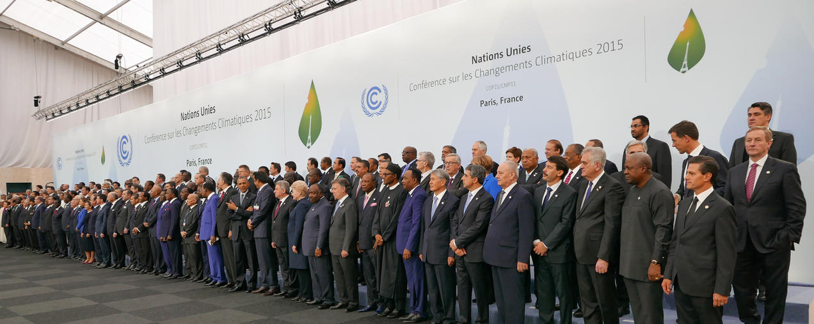
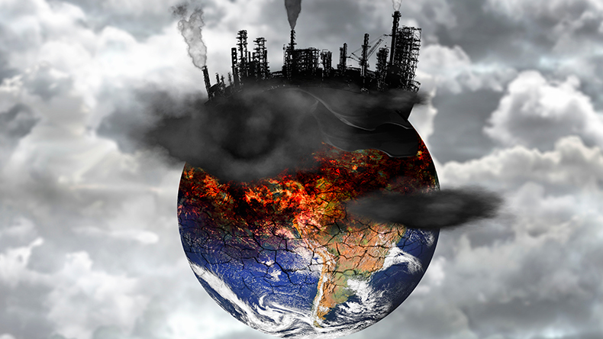
Global Issues and International Agreements
Subject code EMGT-3262
SH5265
BIODIVERSITY LOSS

Slide 2
Name-HVSD Gunasinghe
Cover area –Biodiversity , causes , impacts

Slide 3
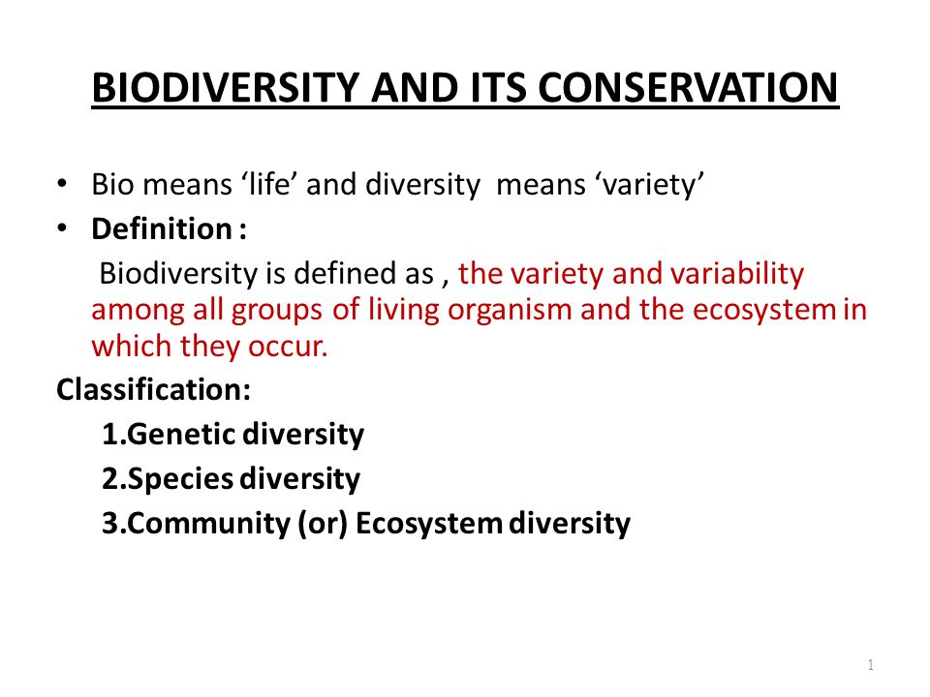
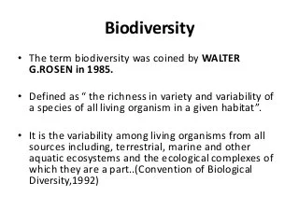
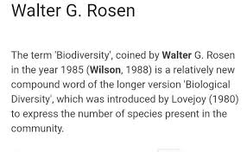
Biodiversity loss

Slide 4
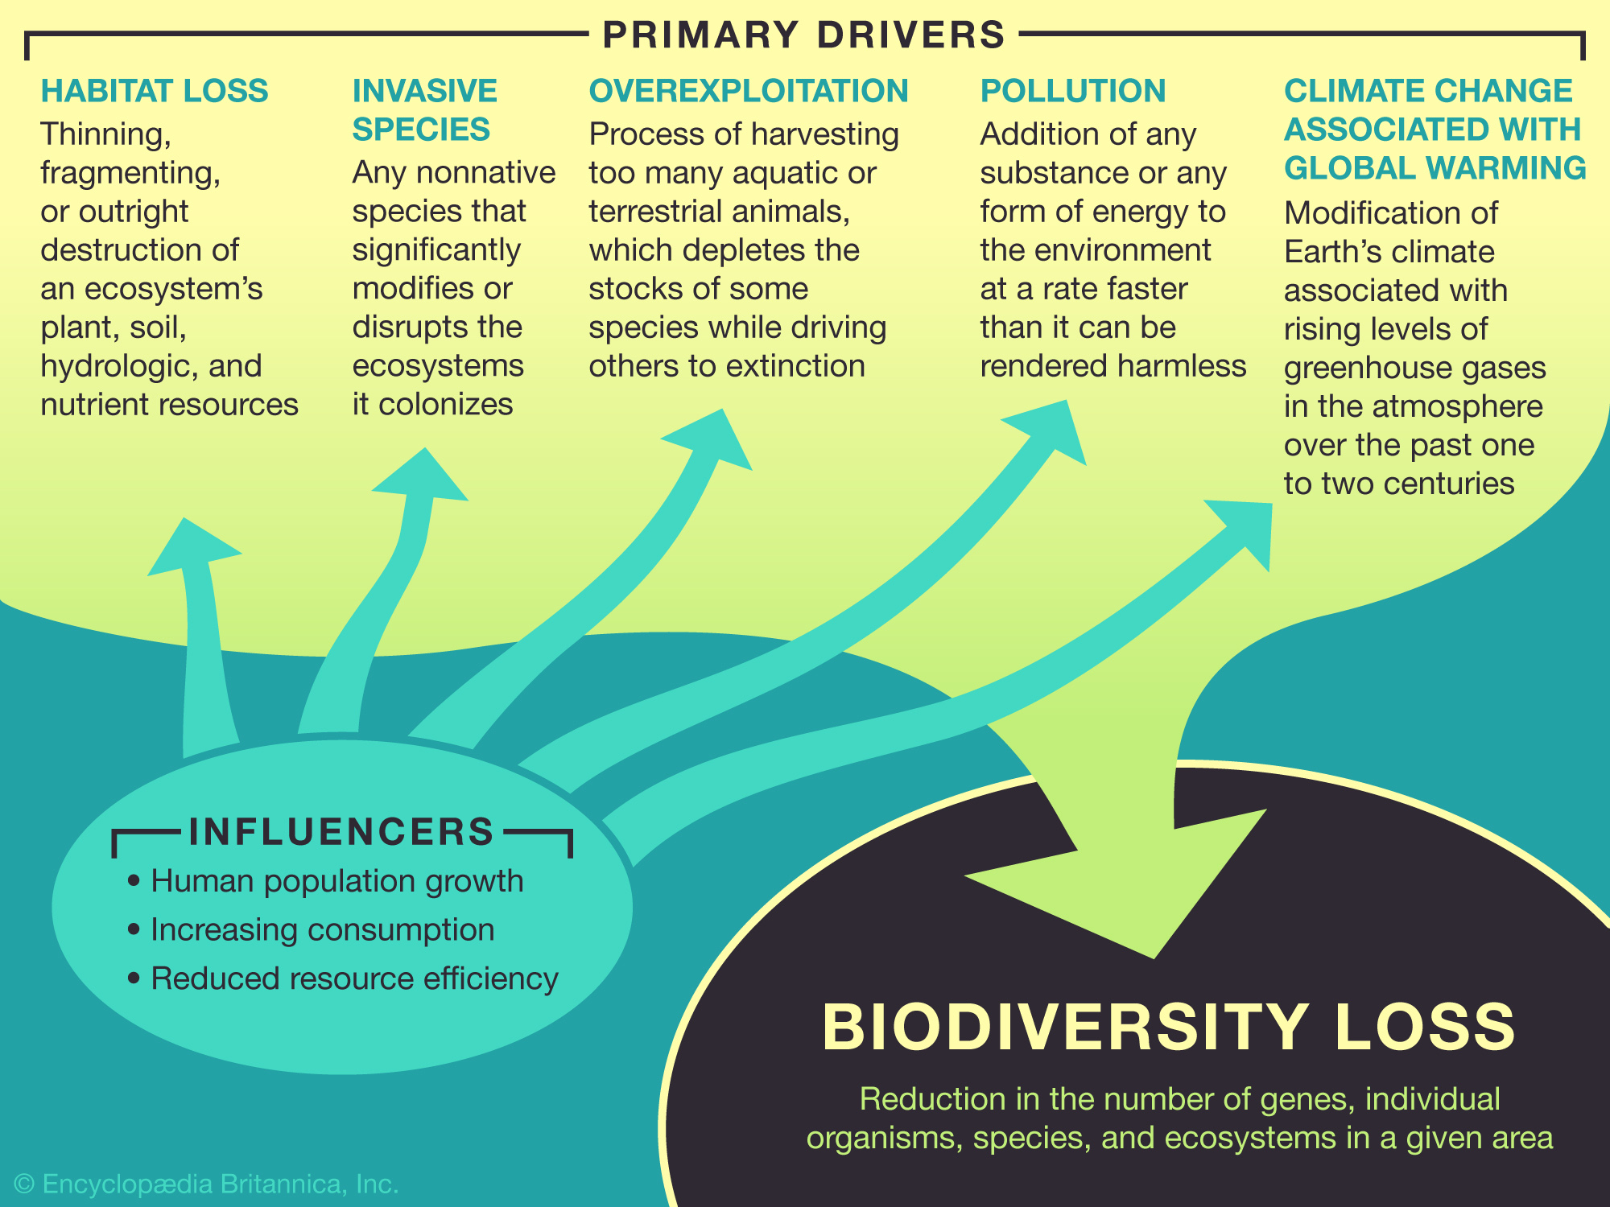

Slide 5
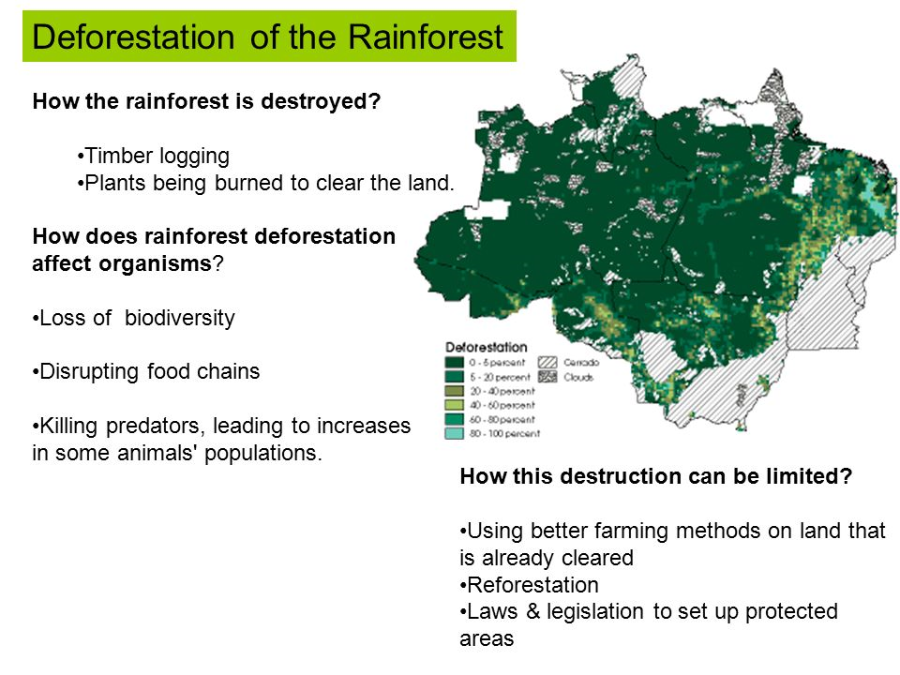

Slide 6
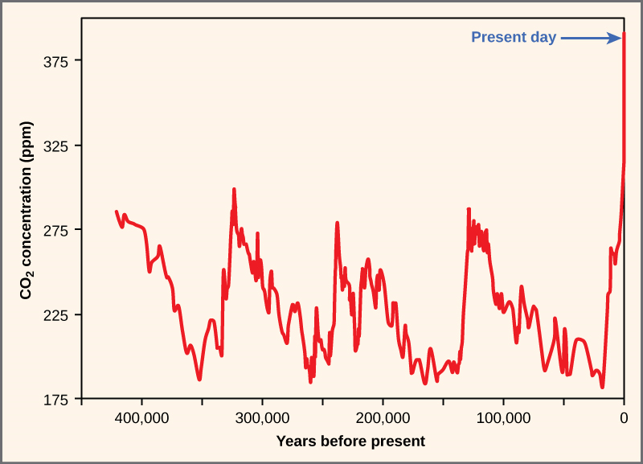

Slide 7
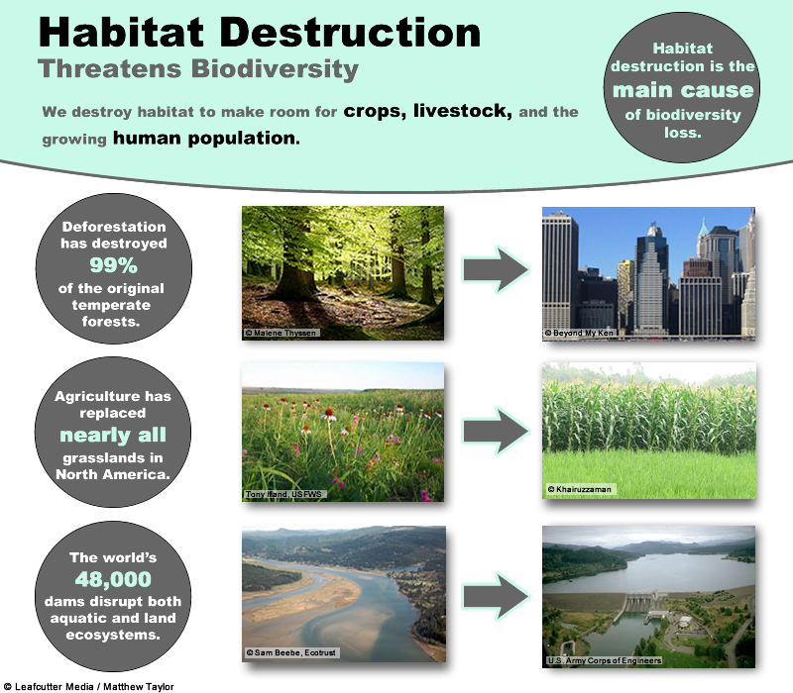

Slide 8
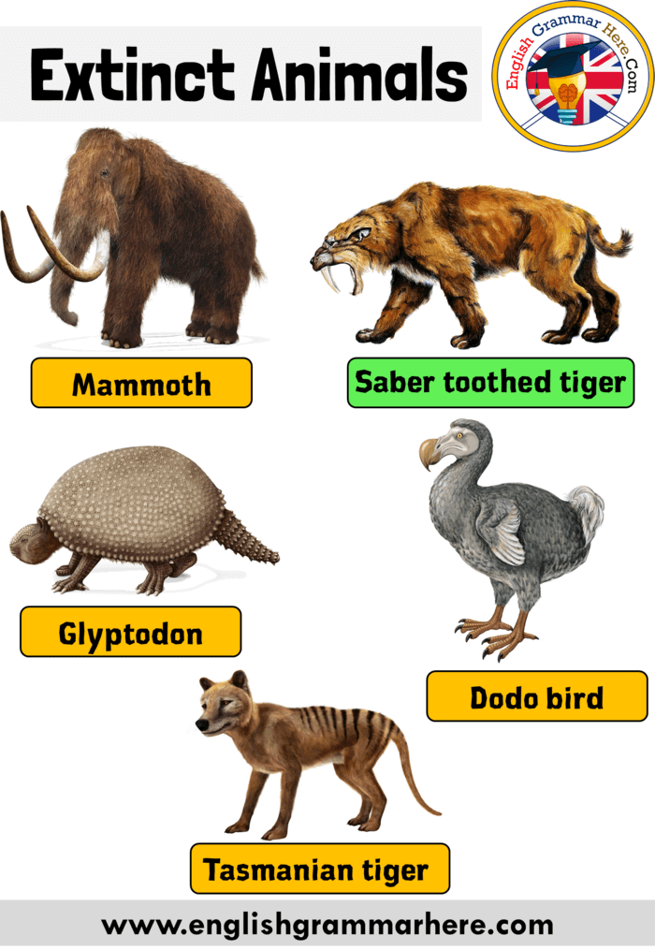

Slide 9
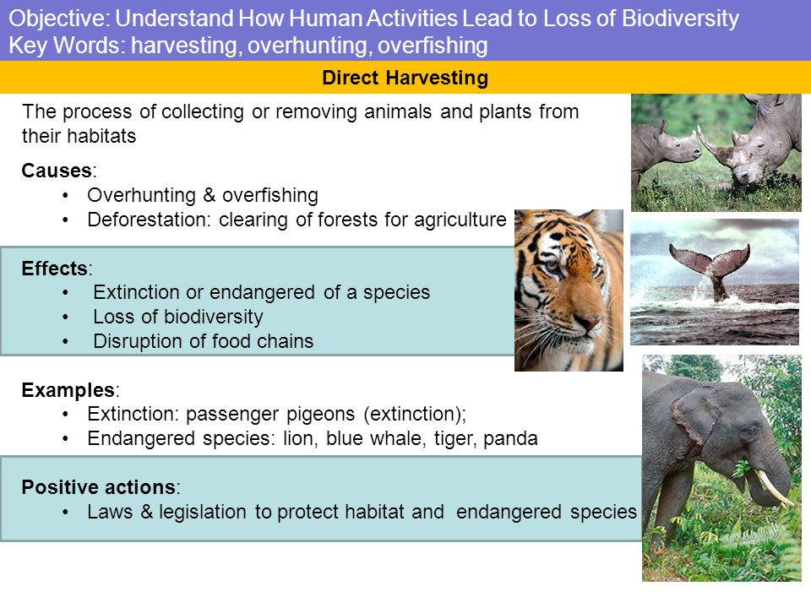

Slide 10
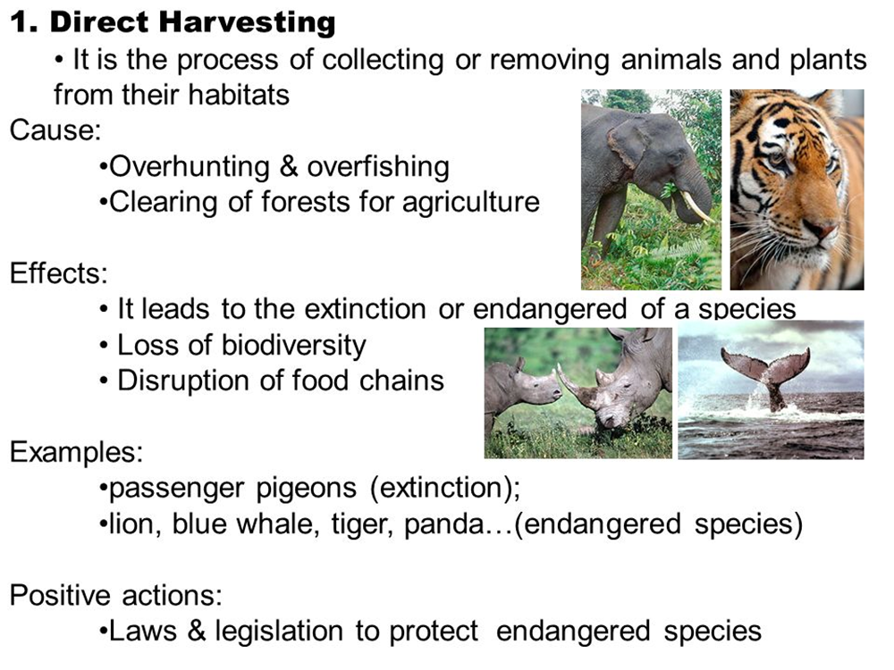

Slide 11
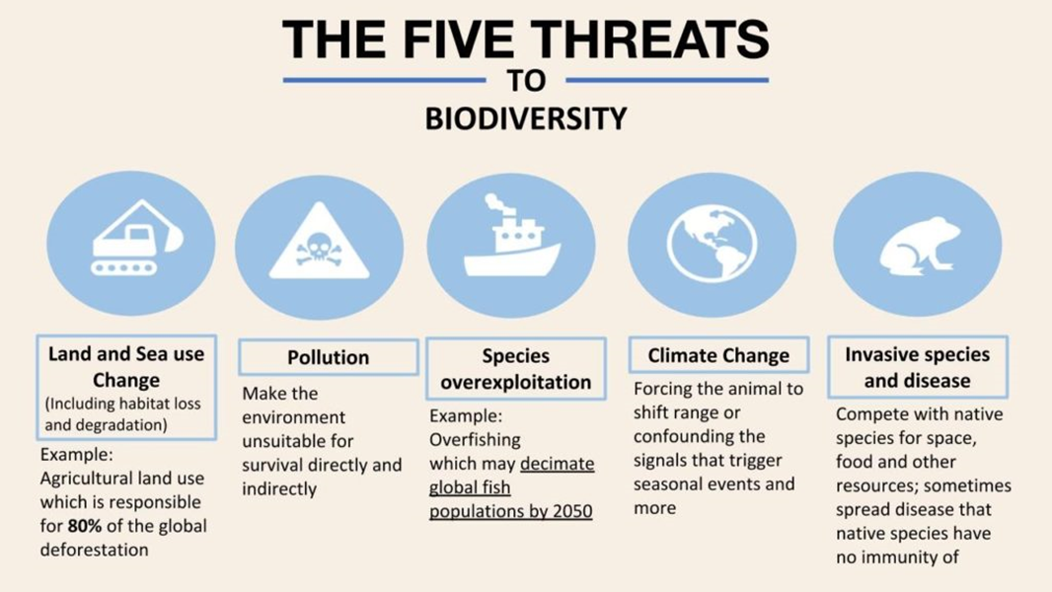
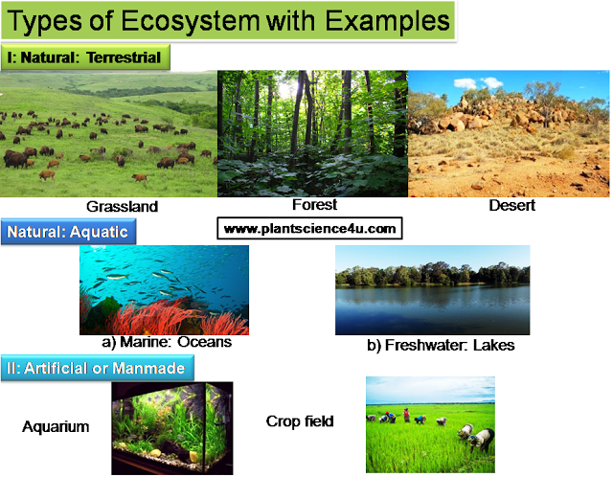
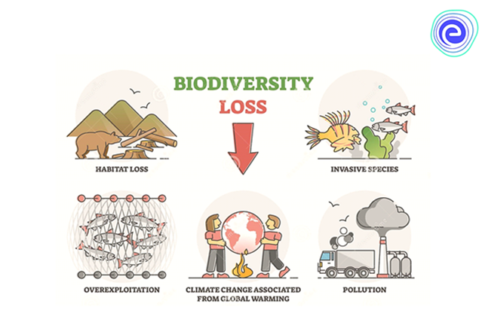

Slide 12
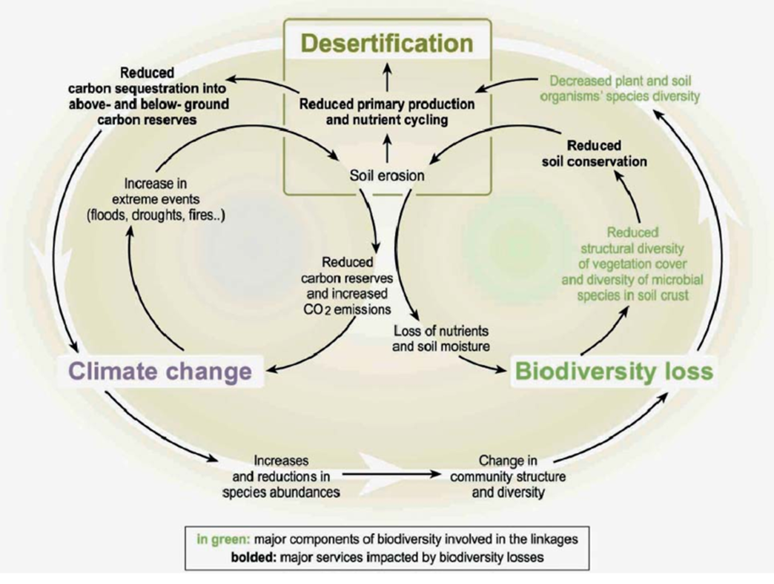

Slide 13
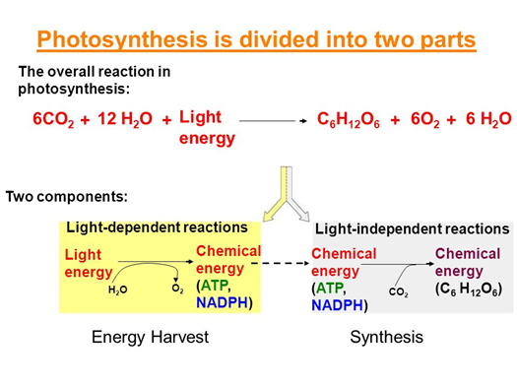
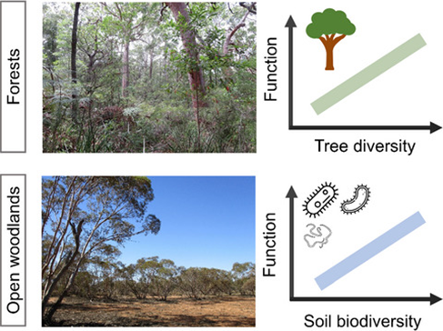

Slide 14
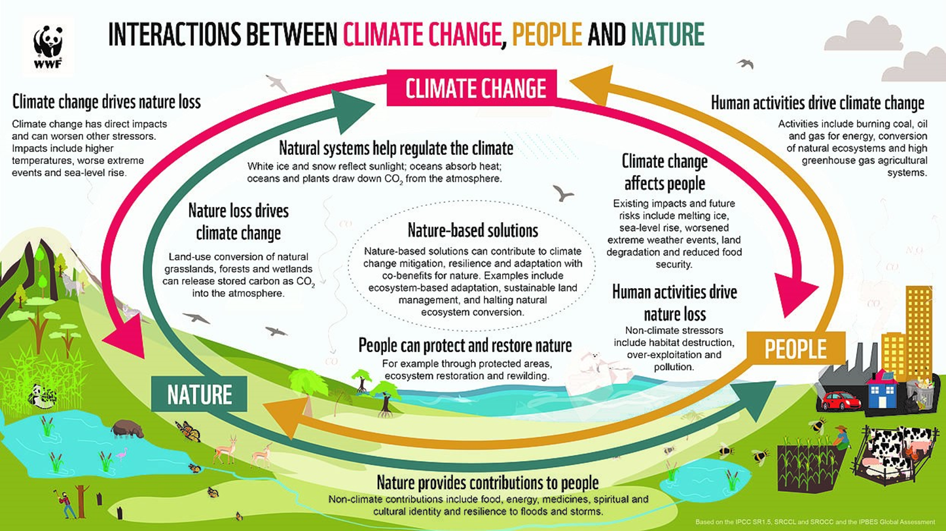

Slide 15
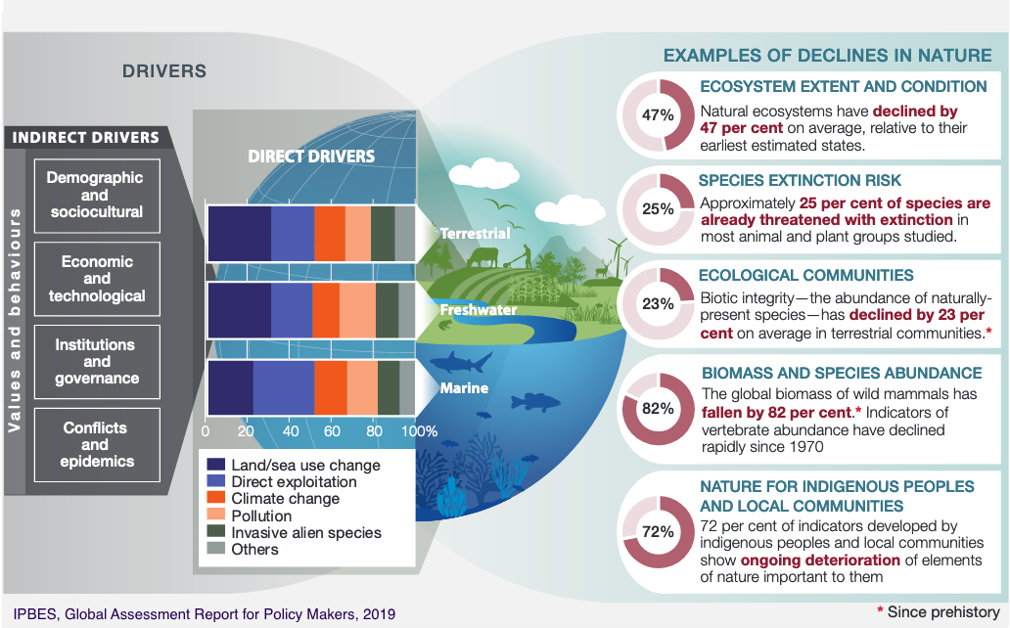

Slide 16
Causes
Drought
Flood
Wildlife
Earthquake
Position and food food chain
Degree od specification
Distraction of habitat
Excessive pollution
Over consumption
Climate change
Hunting
Over exploitation
Conflicts and wars
Invasive species
Solutions
Government restrictions and policies
Education
Protection of species
Protection of habitats
Stop deforestation
Prevent overhunting and over fishing
Prevent species invasion
Stop pollution
Stop over exploitation of resources
save energy
Stop over consumption
Convince others
Effects
Ecological effects
Spread of diseases
Loss of live hood for local
Loss of our recreational space
Society effects
Effect on food production
Economic effects

Slide 17


Slide 18
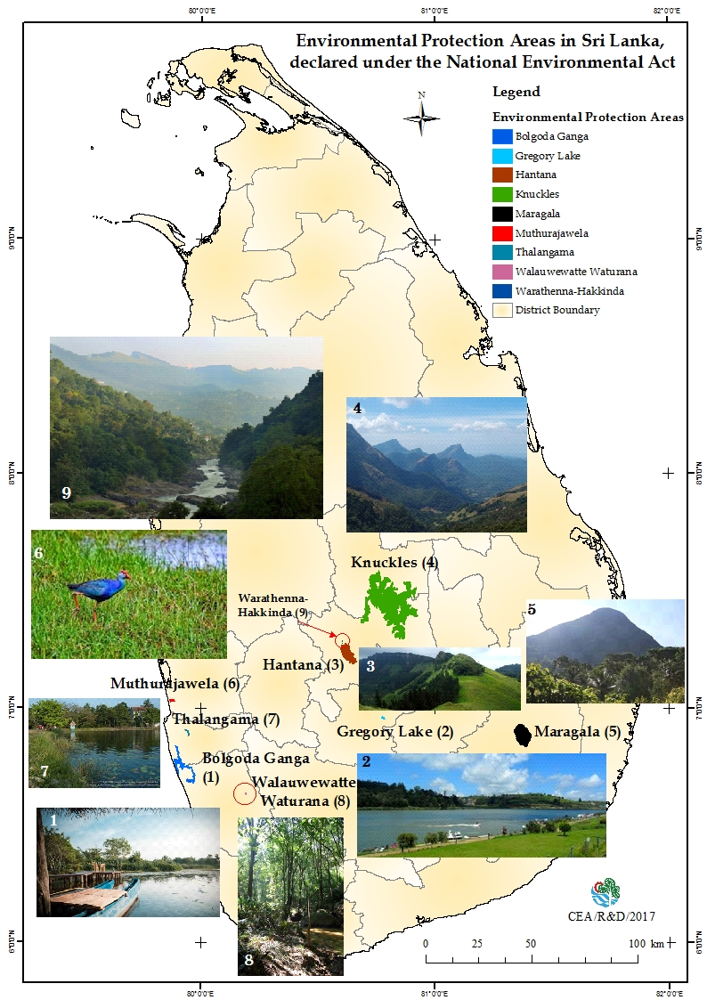
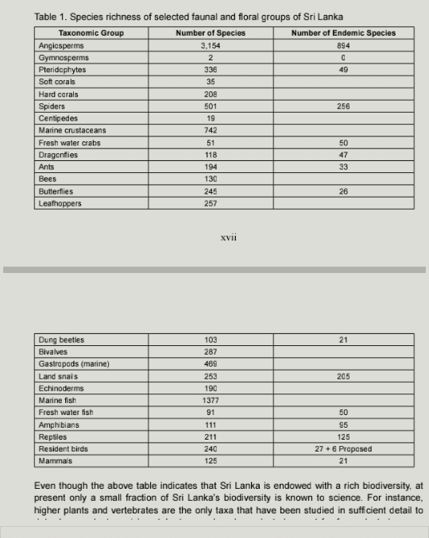

Slide 19
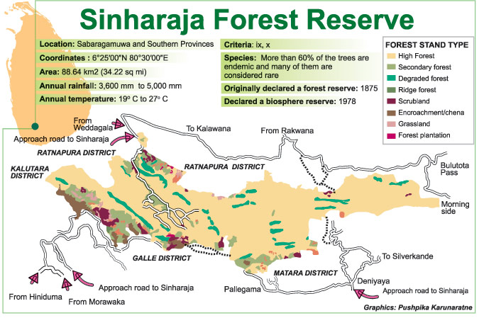
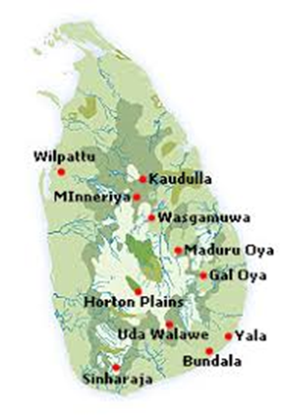

Slide 20
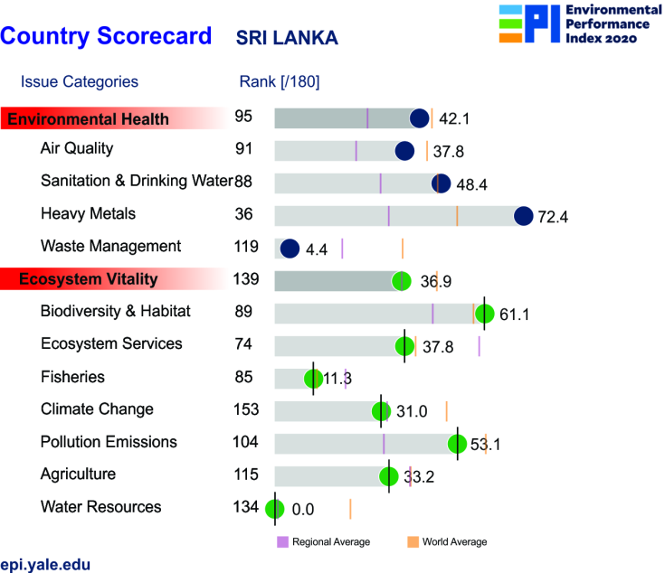

Slide 21
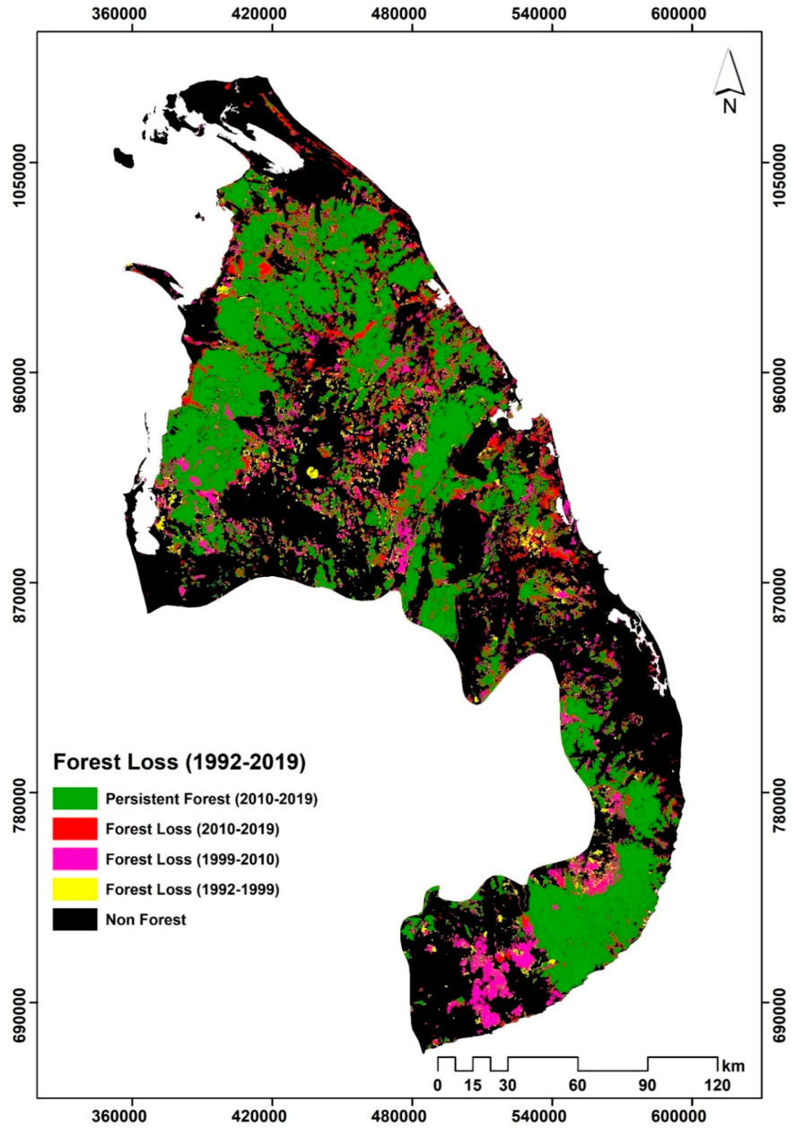
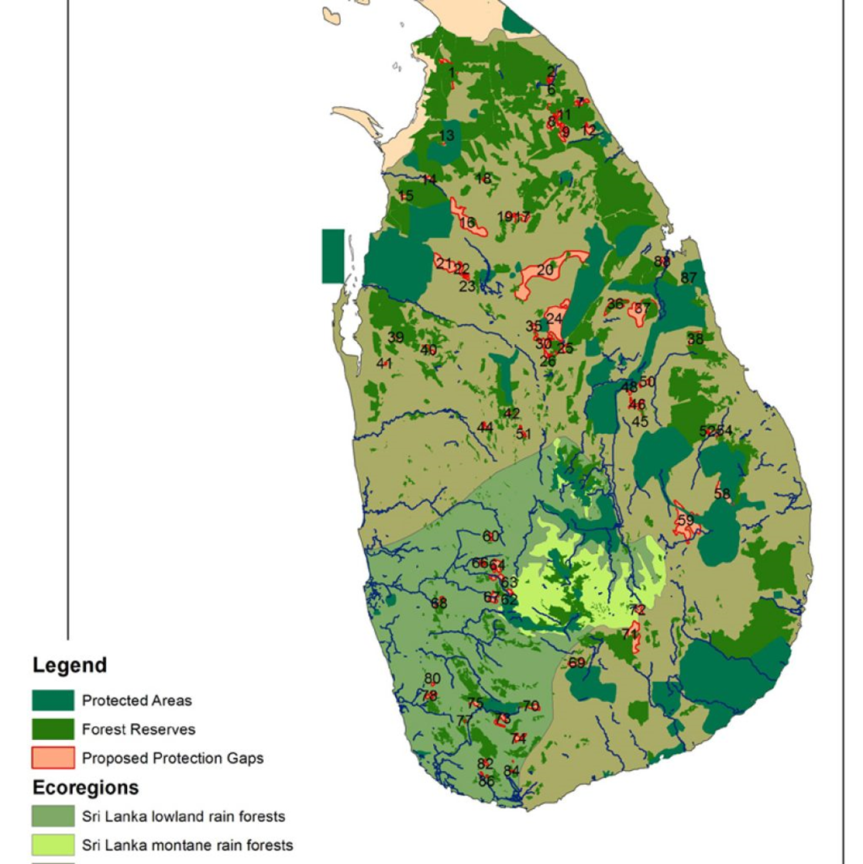
Sri Lanka forests

Slide 22
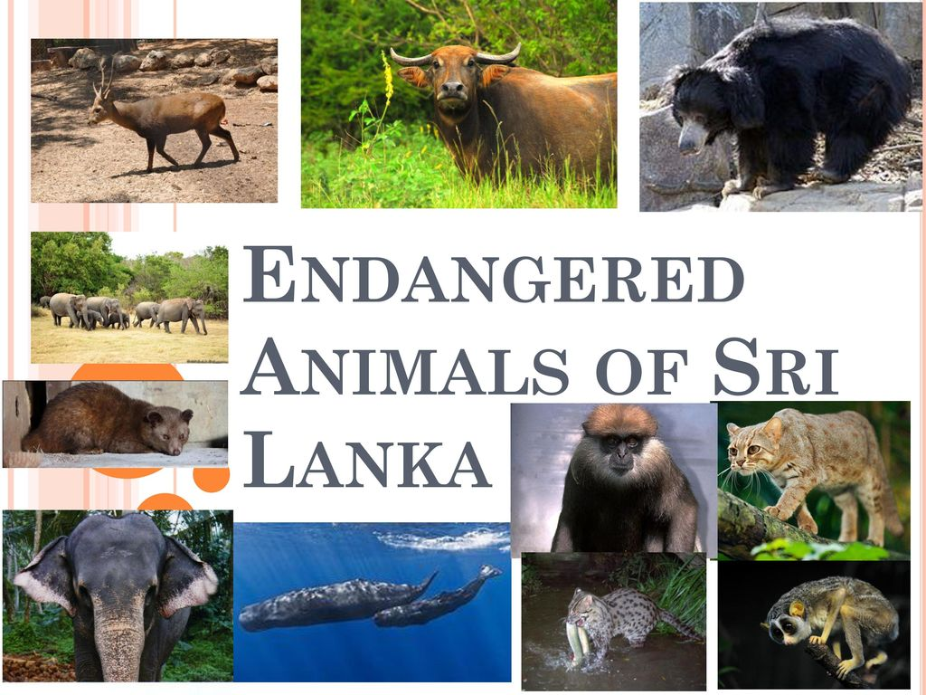

Slide 23
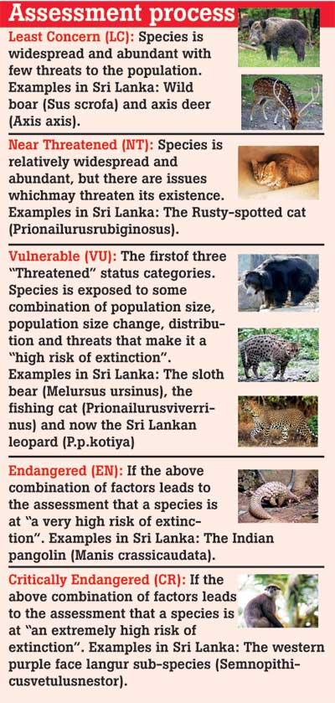
Animals are the most critical endangered in Sri Lanka: 1]NELLU RAT (Rattus montanus) 2]BLACK NECKED STORK (Ephippiorhynchus asasticus) 3]PAINTED FRANCOLIN (Francolinus pictus) 4]JUNGLE BUSH QUAIL (Perdicula asiatica) 5]YELLOW FOOTED GREEN PIGEON (Treron phoenicopterus) 6]SPOT BILLED DUCK (Anus poecilorhyncha) 7]SLATY LEGGED CRAKE (Rallina eurizonoides) 8]JERDON’S BAZA (Aviceda jerdoni) 9INDIAN COURSER (Cursorius coromandelicus) 10]HOG DEER (Axis porcinus) 11]BLUE ROCK PIGEON (Columba livia) 12BLUE EARED KINGFISHER (Alcedo meninting).

Slide 24
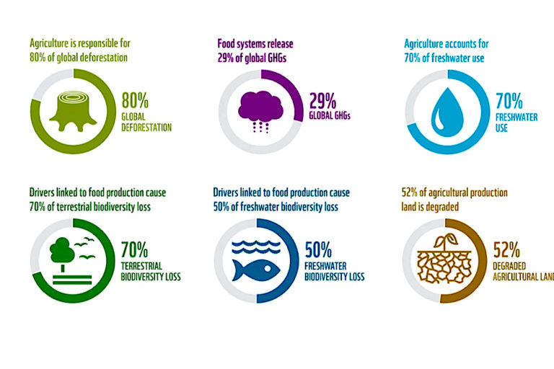
Biodiversity Beyond Sri Lanka

Slide 25
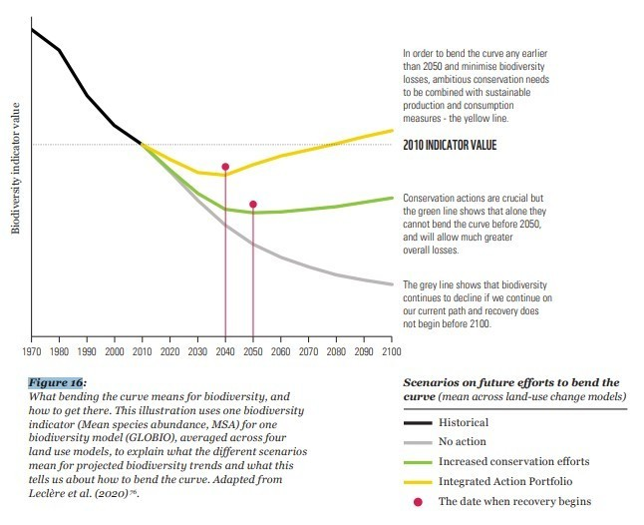
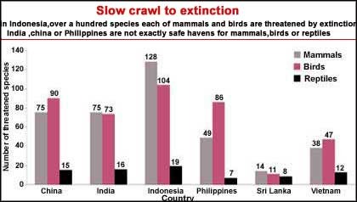
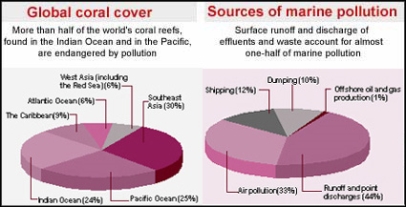
Biodiversity loss

Slide 26
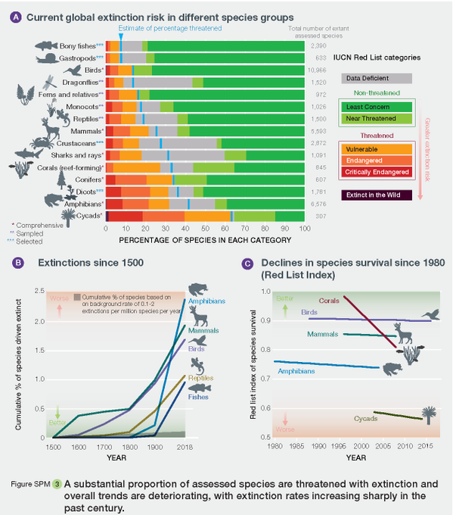
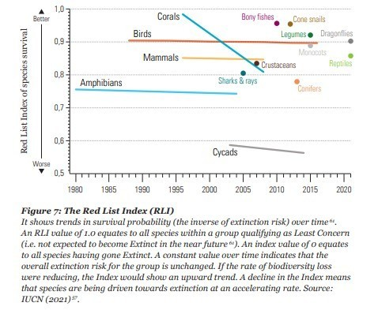
Extinction

Slide 27
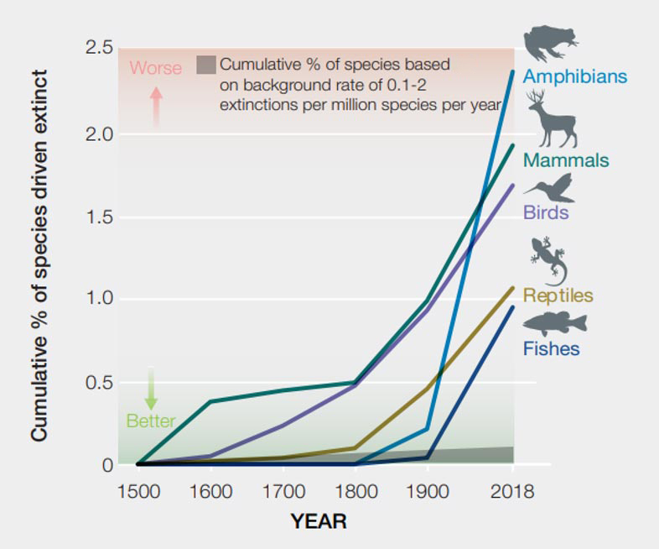
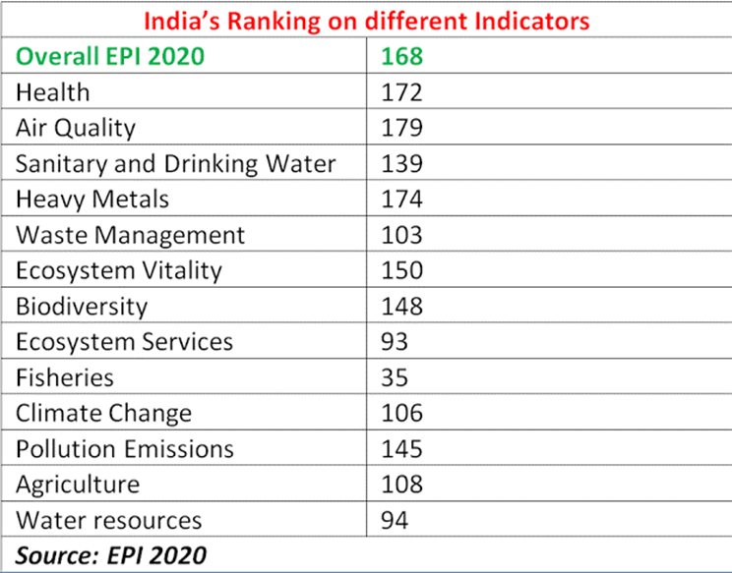
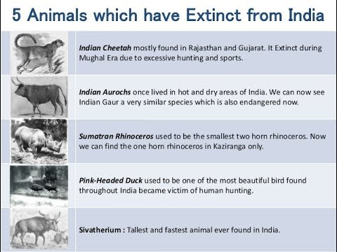

Slide 28
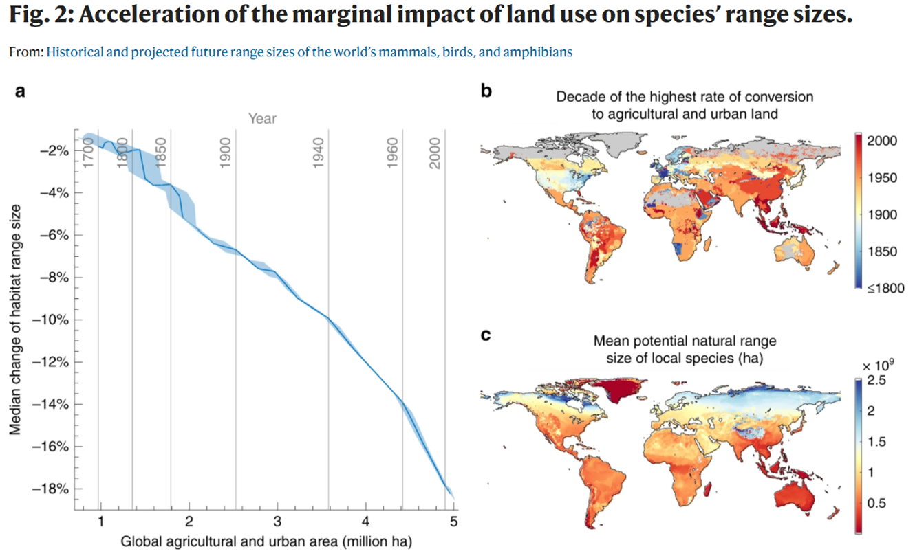

Slide 29
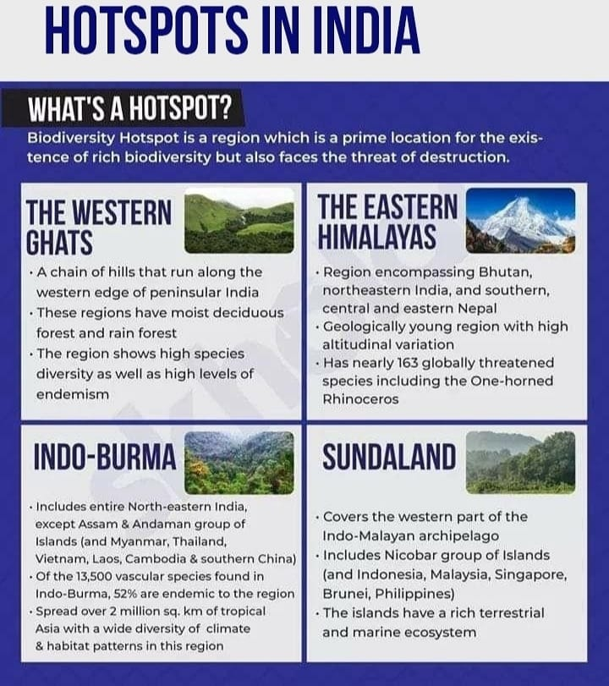
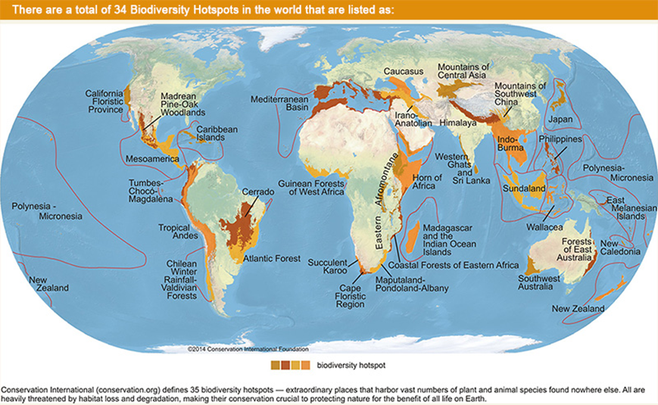
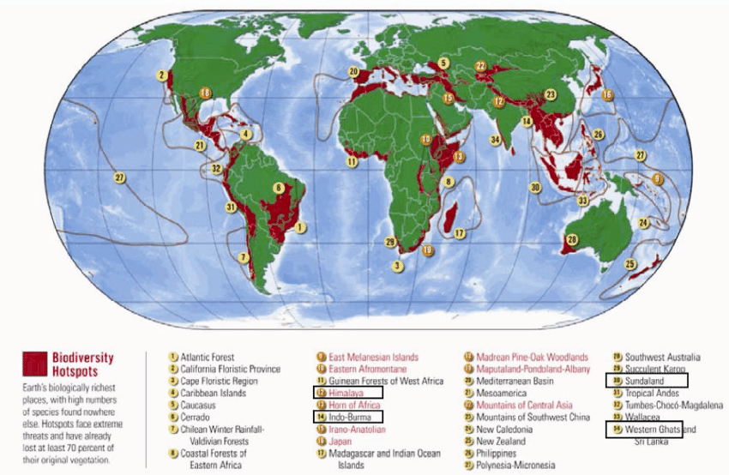

Slide 30
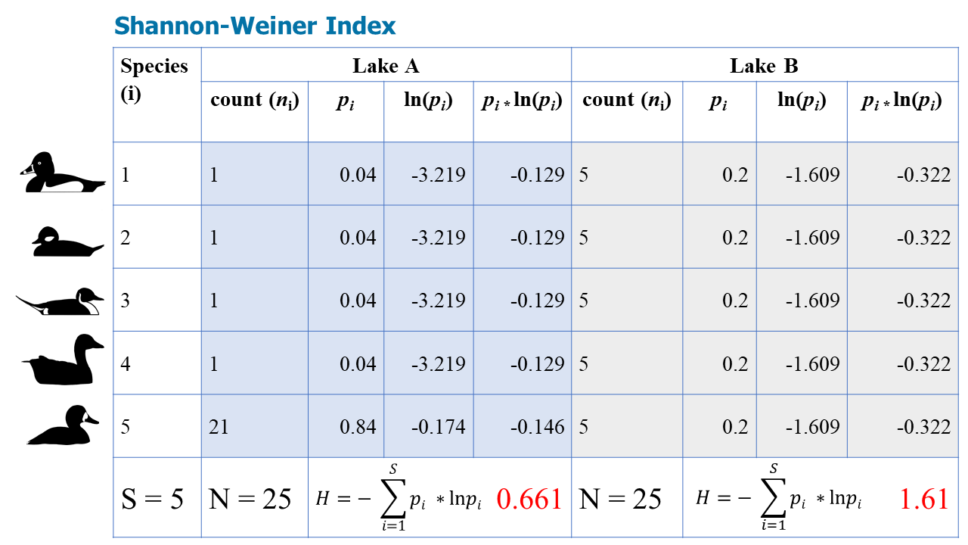
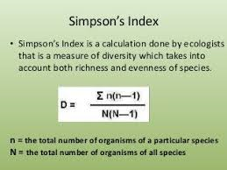
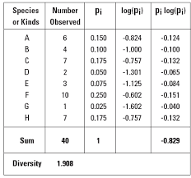

Slide 31
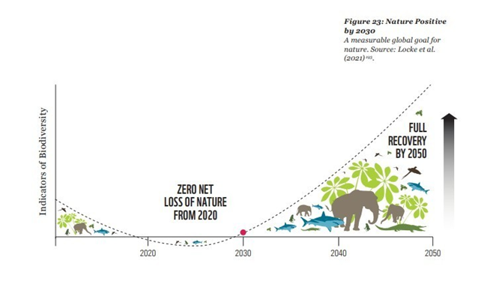
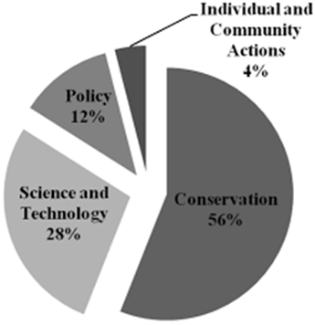

Slide 32
Conclusion
Quantity of plant and animal species found in a given environment. Sometimes habitat diversity (the variety of places where organisms live) and genetic diversity (the variety of traits expressed within a species) are also considered types of biodiversity.
The estimated 3–30 million species on Earth are divided unequally among the world’s habitats, with 50–90% of the world’s species living in tropical regions.
The more diverse a habitat, the better chance it has of surviving a change or threat to it, because it is more likely to be able to make a balancing adjustment.
Habitats with little biodiversity (e.g., Arctic tundra) are more vulnerable to change. The 1992 Earth Summit resulted in a treaty for the preservation of biodiversity.

Slide 33
References
Hancock, L. (2019). What is biodiversity and why is it under threat? [online] World Wildlife Fund. Available at: https://www.worldwildlife.org/pages/what-is-biodiversity.
Faith, D.P. (2010). Biodiversity (Stanford Encyclopedia of Philosophy). [online] Stanford.edu. Available at: https://plato.stanford.edu/entries/biodiversity/.
BYJUS. (n.d.). What Is Biodiversity? - Definition, Types And Importance,. [online] Available at: https://byjus.com/biology/biodiversity/.
33 10/21/2022

